Slide 1



Trip Planter
A website that leverages multiple sources to help users plan trips.

Slide 2

User Persona
Dimitris is a 24 year old student.
He spends a lot of time studying for ITECH.
In his spare time he likes travelling and organizing trips.

Slide 3
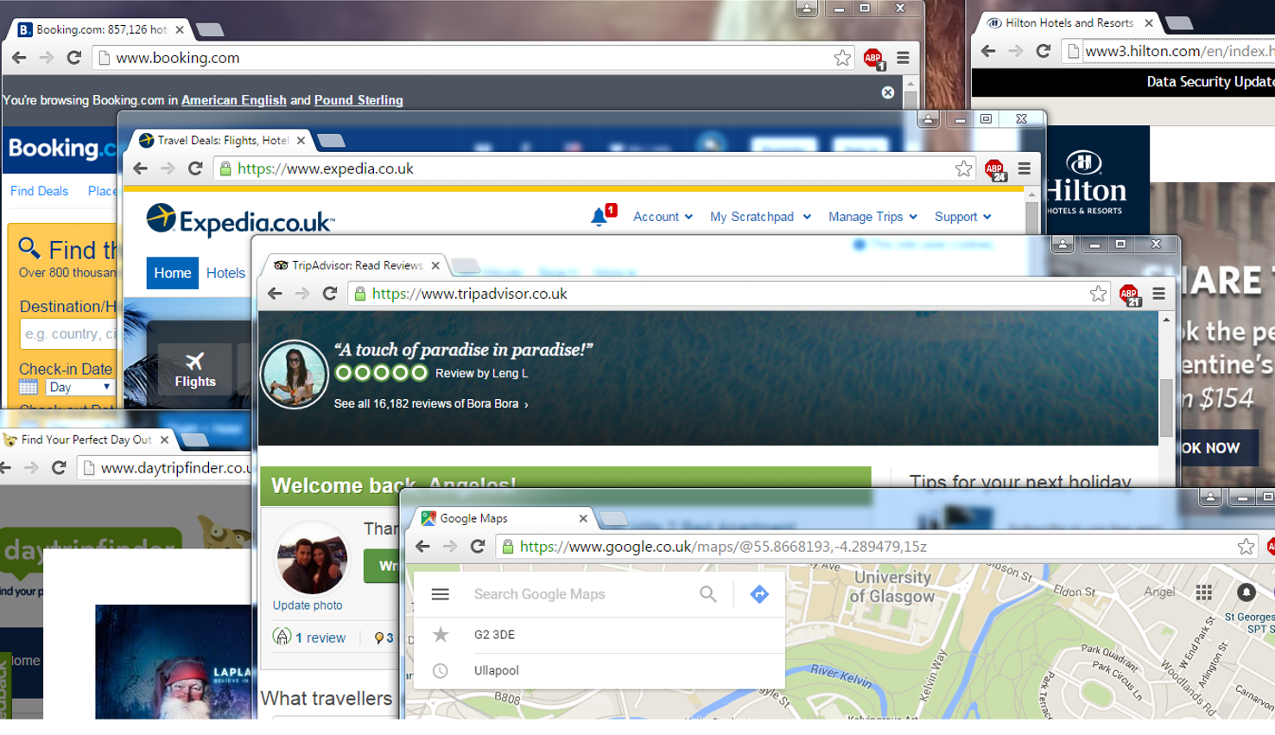
User Persona
Whenever he is planning a trip he has to seek information from multiple sources.
And spends a lot of time calculating the budget for his trip.
He wants to spend less time planning and more time travelling.

Slide 4

User Persona
Andrew, hotel owner
Spends a lot of time growing his business
He is looking for an easy way to advertise his business

Slide 5



Why is it cool!?
You save time when planning trips.
Can share your trip with others.
Estimate budget.
Suggested trips.

Slide 6
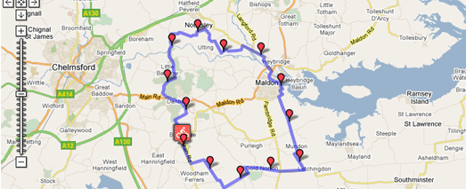


Main Requirements
Users can easily plan trips
Users can view an estimated budget
Business owners can advertise their businesses

Slide 7
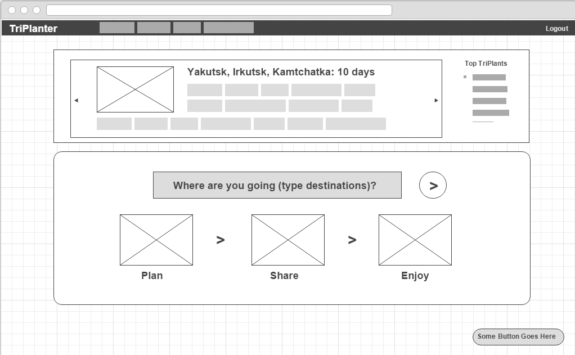
Wireframes: Main Screen

Slide 8
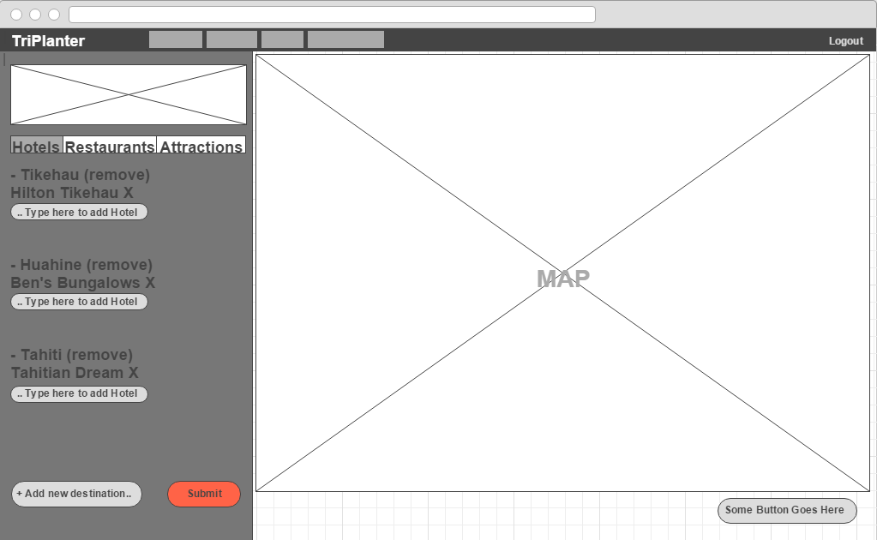
Wireframes: Plan Trip Screen

Slide 9
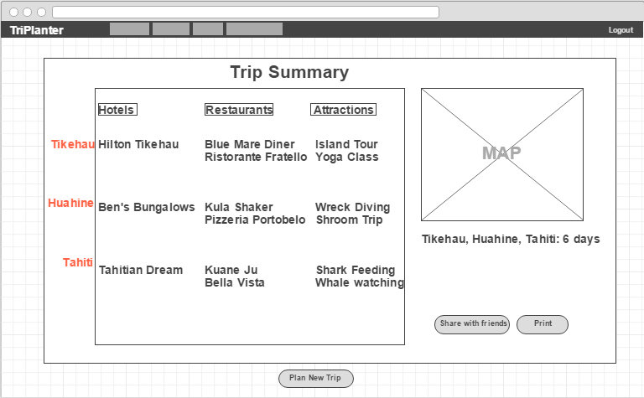
Wireframes: Summary

Slide 10
System Architecture Design

Slide 11
ER-Diagram
Planner
1
N
Trip
1
N
Visit
plans
Consists of
M
Consists of
1
Reviewer
1
Review
1
Place
N
M
creates
has
N
d
Business Owner
1
owns
Hotel
Restaurant
Attraction

Slide 12
Attributes

